Slide 1
Disease prediction using machine learning
By
shiva kommareddy
00669845

Slide 2

What the project is about
The project is all predicting a disease for the symptoms given by the user based on the trained data set.

Slide 3
How it works
Initially user is asked to give few details like name and symptoms user is having.
After entering the required details user is given three options (i.e. to select the algorithm) to predict the disease based on the given symptoms.

Slide 4
Data set used
Training data set: the data set consists of two main things namely features and labels.
Features are the different kinds of symptoms which generally cause a disease which are considered as labels.
In total there are 40 labels which are being considered based on several symptoms.

Slide 5
Data set used ….contd
Testing data set: this data set is derived from the training data set.
Sample of training data set is considered in the testing data set.
In both the data sets labels are replaced to numerical values for e.g.
Before replacement | After replacement
Fungal infection | 0
Allergy | 1
Paralysis | 13

Slide 6
Algorithms used
In this project I have used three algorithms which are already present in the anaconda installed libraries.
I have imported three different algorithms namely decision tree, Naive Bayes and random forest algorithm and their results are compared with the given symptoms by the user.

Slide 7
Libraries used
Tkinter
Numpy
Pandas
Sklearn

Slide 8
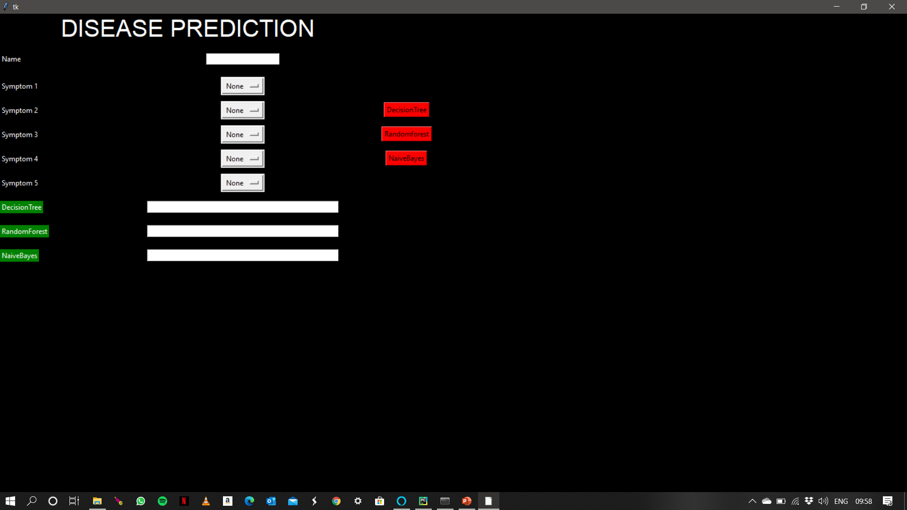
Screenshot 1
When the user runs the program

Slide 9
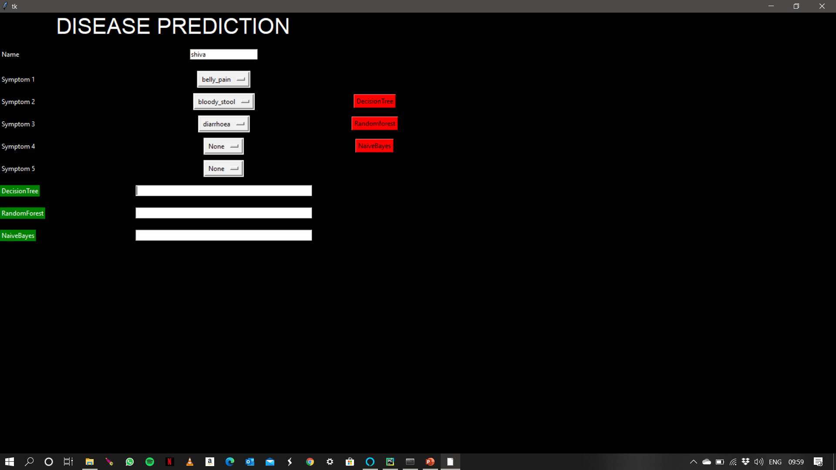
Screenshot 2
When user enters the required details

Slide 10

Screenshot 3
When the algorithms are run and the output is shown

Slide 11

Demo
https://youtu.be/6wevgOKZecY

Slide 12
Code

Slide 13
Thank you

